Slide 1
Technology is not an afterthought:
TPACK as a Framework for ICT Integration into Teacher Professional Development
Dr. M’hammed Abdous
Old Dominion University, Norfolk, Virginia

Slide 2
Outline
Technology Then and Now
The Technological Divide: Haves and Have-Nots
Technology Integration Models: SAMR & LOTI
What is TPACK?
TPACK Cards Game
What Does ALL This MEAN to YOU?

Slide 3
Goals
Discuss the concept of technology integration
Gain familiarity and experience with the TPACK framework
Discuss the TPACK framework opportunities and constraints
Identify potential challenges associated with TPACK implementation and brainstorm possible solutions for these challenges

Slide 4
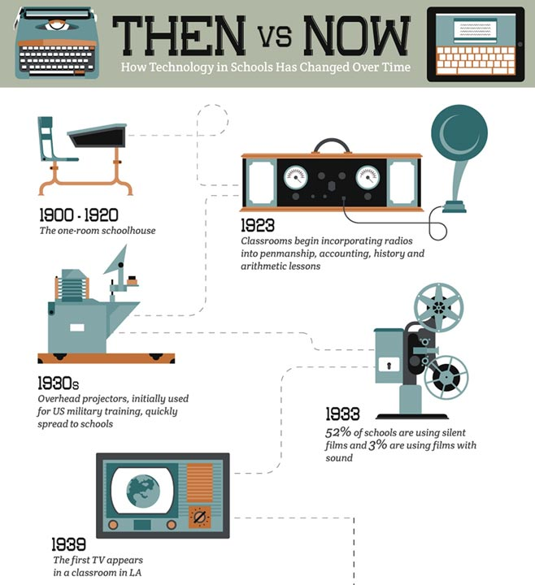
It took 500 years to distribute arithmetic textbooks in schools
In 1924 the BBC broadcasted the first adult education radio talk on Insects in Relation to Man
Notes:
http://www.masterofartsinteaching.net/tech/
Arithmetic
https://books.google.com/books?isbn=0080871445
BBC
http://www.tonybates.ca/tag/radio/

Slide 5
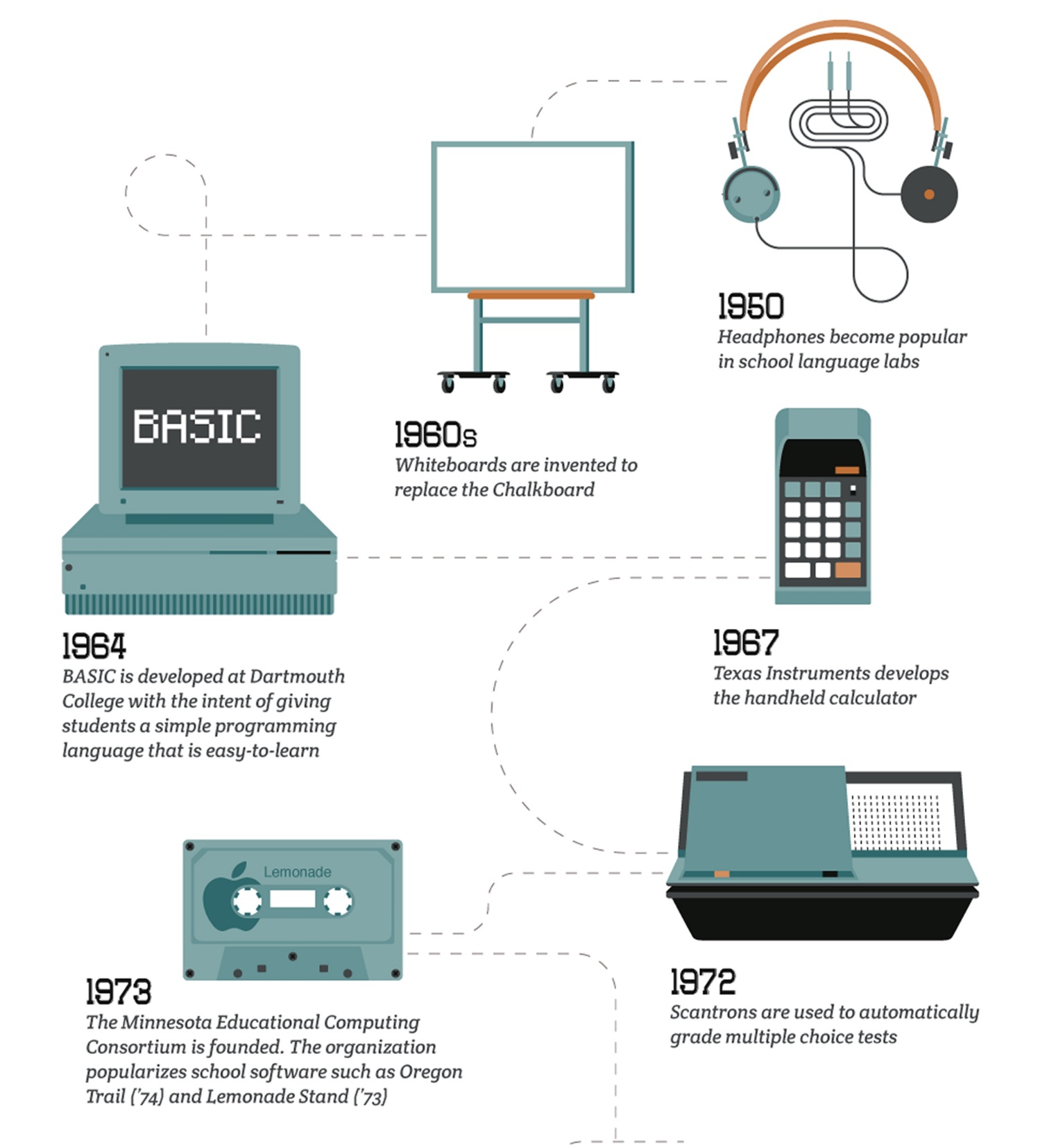
In the 1970, TV was seen as a panacea, but…
Lack of electricity, cost, climate, resistance from local teachers, language and cultural barriers…
The Automated Test Scoring Machine was developed by IBM in 1937
Notes:
http://www.masterofartsinteaching.net/tech/

Slide 6
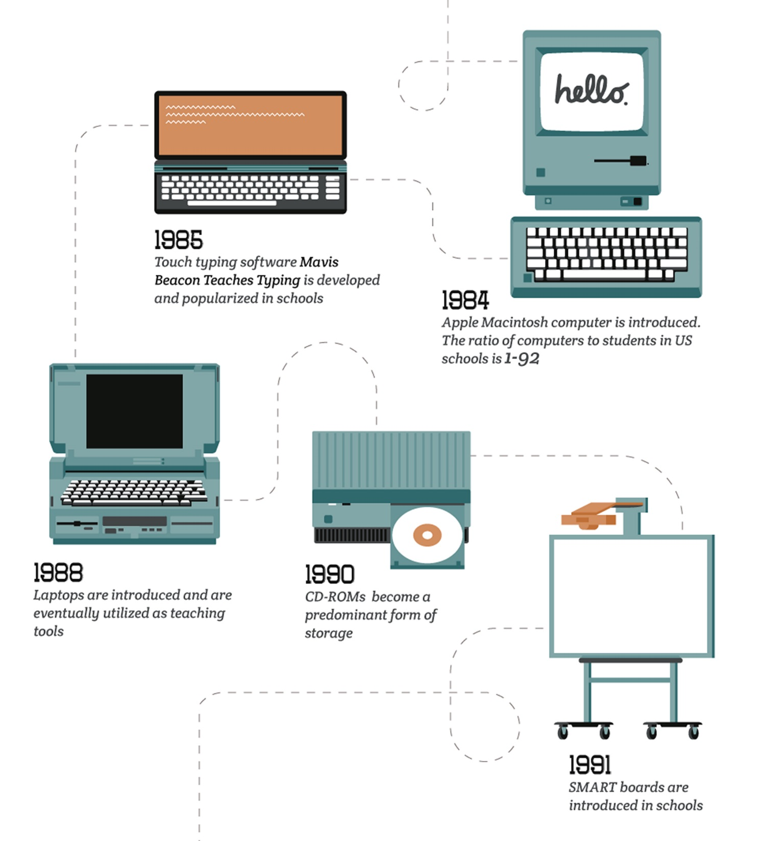
Notes:
http://www.masterofartsinteaching.net/tech/

Slide 7
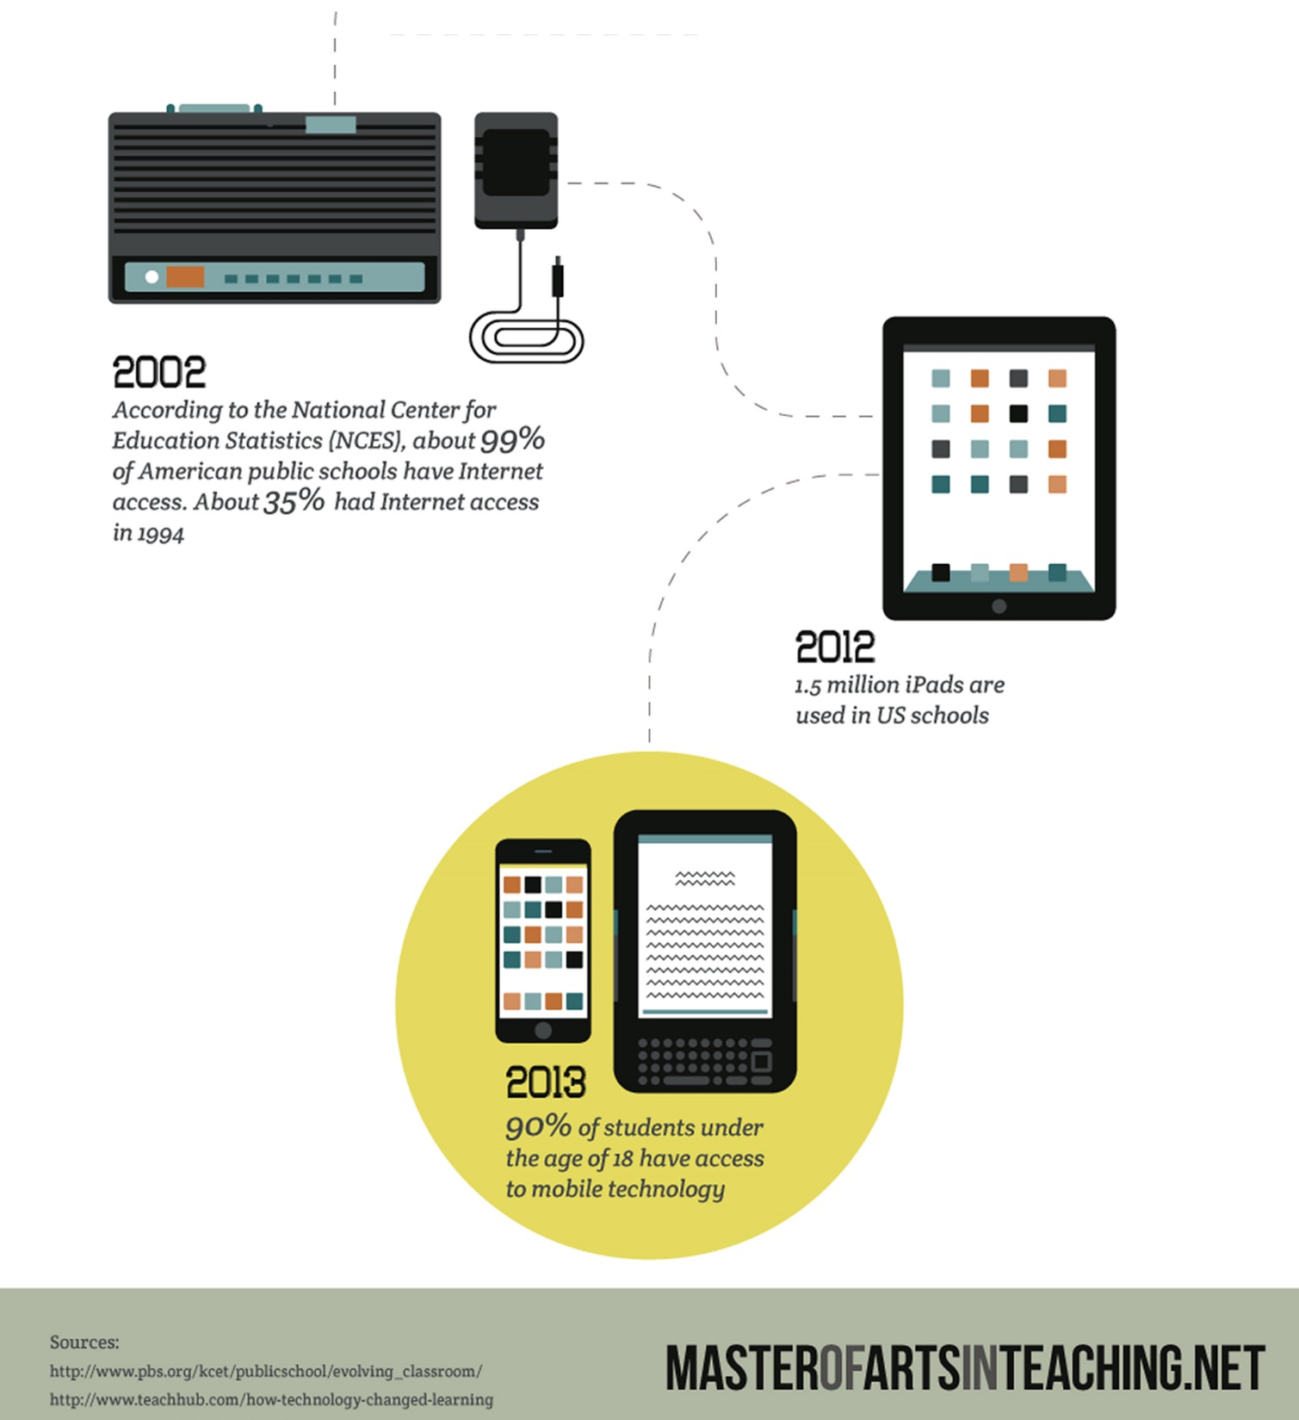
Notes:
http://www.masterofartsinteaching.net/tech/

Slide 8
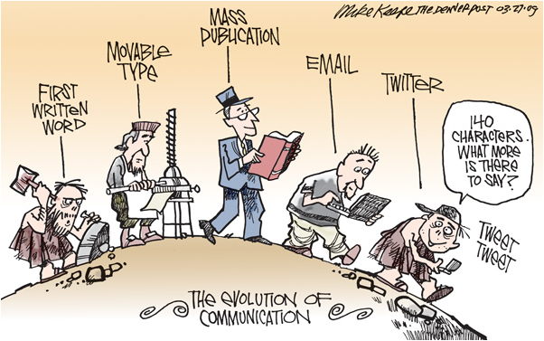
The Evolution of Communication
Notes:
http://www.communiquepr.com/blog/?p=2052
Photo Credit: Mike Keefe, The Denver Post & InToon.com

Slide 9
Some the Unfulfilled Promises of Technology
Is technology mechanizing the industrial model of schooling: large number of factory workers?
Where’s the individualized learning experience?
Can you offer a personalized learning path for children at scale?

Slide 10
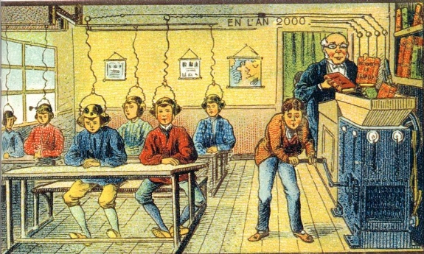
The School of the Future
Notes:
Open this video:
https://youtu.be/mPUfwX4Nqy8

Slide 11
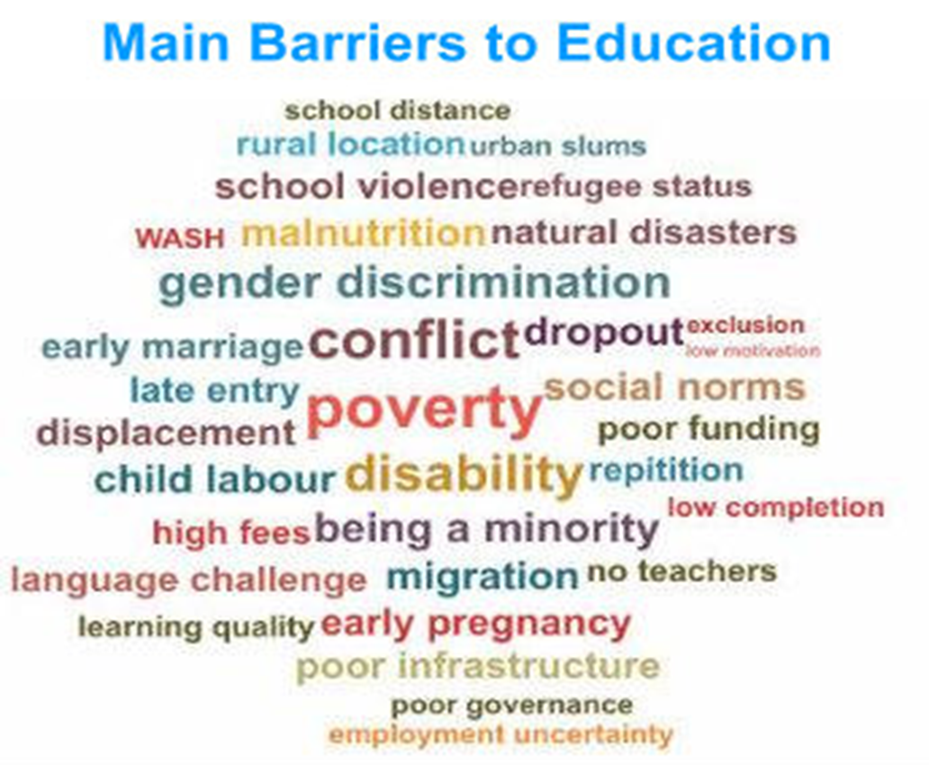
Out-Of-School Children
Notes:
http://allinschool.org/

Slide 12
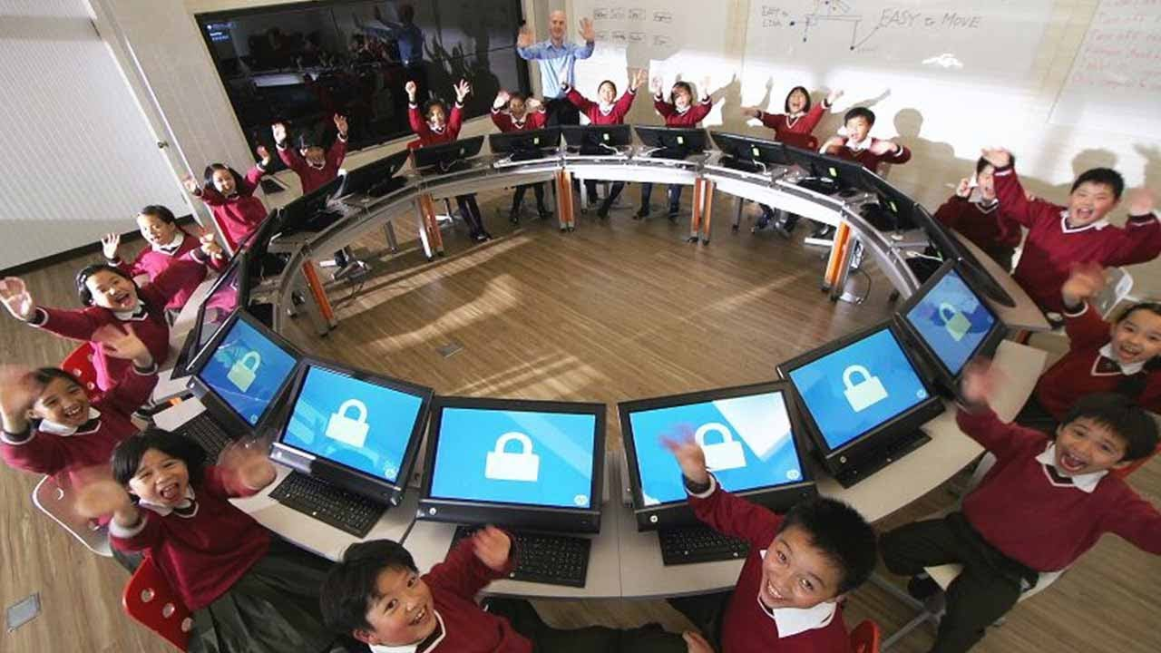
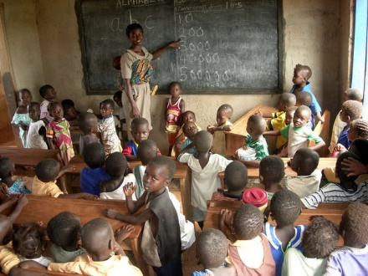
The Technological Divide: Haves and Have-Nots
Digital Divide
74 students
47 girls
27 boys
Madame Judith uses her meager salary to buy food, clothing and sandals for the children whose parents cannot afford them.
School fees in the public schools are around three dollars per year.
Notes:
Picture on left
https://youtu.be/mPUfwX4Nqy8
Picture of right
https://www.travelblog.org/Photos/1703331

Slide 13
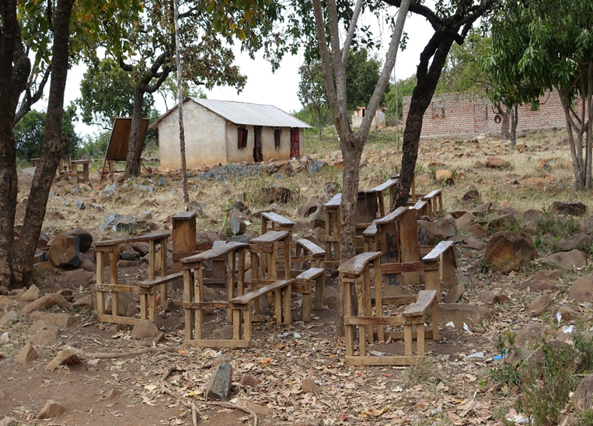
The Technological Divide: Haves and Have-Nots
Digital Divide
Notes:
Picture on left
https://youtu.be/mPUfwX4Nqy8
Picture of right
https://johnageddes.com/2015/01/30/elementary-school-visits/

Slide 14
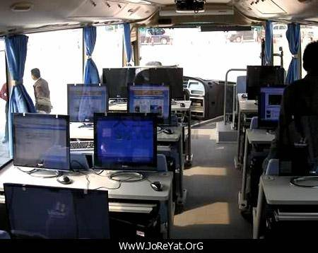
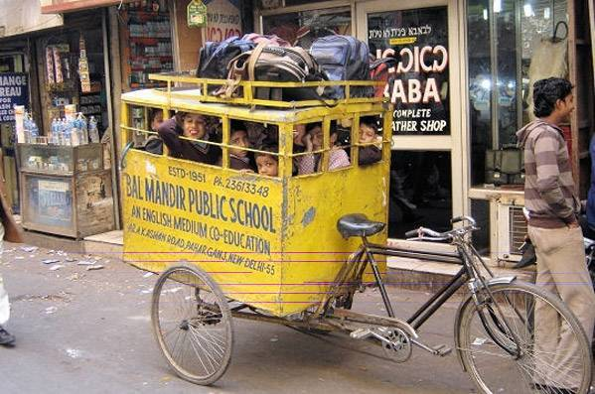
The Technological Divide: Haves and Have-Nots
Digital Divide
Notes:
http://message.snopes.com/showthread.php?t=50675

Slide 15
21 Century Skills
Information Literacy | A set of abilities requiring individuals to "recognize when information is needed and have the ability to locate, evaluate, and use effectively the needed information."
ICT Literacy | the ability to “use digital technology, communications tools, and/or networks to access, manage, integrate, evaluate, and create information in order to function in a knowledge society.”
Notes:
http://www.ala.org/acrl/standards/informationliteracycompetency
American Library Association
Educational Testing Service. (2002) Digital Transformation A Framework for ICT Literacy: A Report of the International ICT Literacy Panel. ETS: New Jersey, p. iii.

Slide 16
Technology Infusion or Integration?
Introducing a new element into an existing process
Word Processing for Writing, Editing and Revising
Intermixing items that were initially separated
Creating a multimedia presentation with text, audio, photos, and video
What is effective technology integration?

Slide 17
What is technology Integration?
Effective technology integration is attained when
Technology use is routine and transparent, accessible and readily available
Supporting curricular goals
Helping students learn
Notes:
https://www.edutopia.org/technology-integration-guide-description

Slide 18
Technology Integration Models
SAMR
LOTI
TPACK

Slide 19
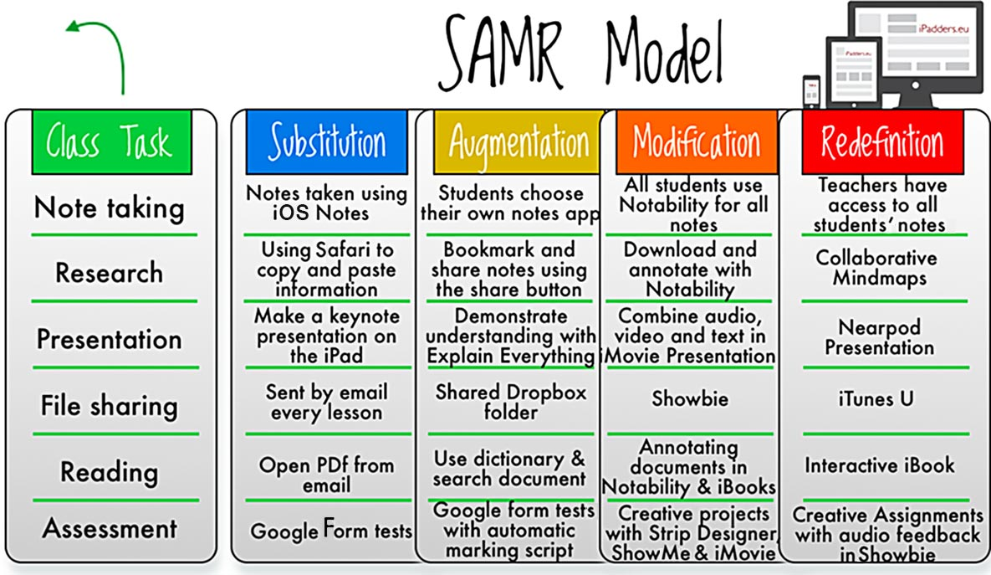
Notes:
http://www.schrockguide.net/samr.html

Slide 20
LOTI: Levels Of Technology Integration
A conceptual framework to measure levels of technology implementation
Level 0 – Non-use
Level 1 – Awareness
Level 2 – Exploration
Level 3 – Infusion
Level 4 – Integration (a: mechanical, b: routine)
Level 5 – Expansion
Level 6 – Refinement
Self-assessment tool for technology integration, but ….
Unclear knowledge domains associated with each level
Notes:
https://sites.google.com/site/learningwithmiguel/workshops/models-of-technology-integration

Slide 21
TPACK
What is the TPACK?
What are the underlining ideas of the TPACK?
Notes:
http://www.matt-koehler.com/tpack/tpack-explained/

Slide 22
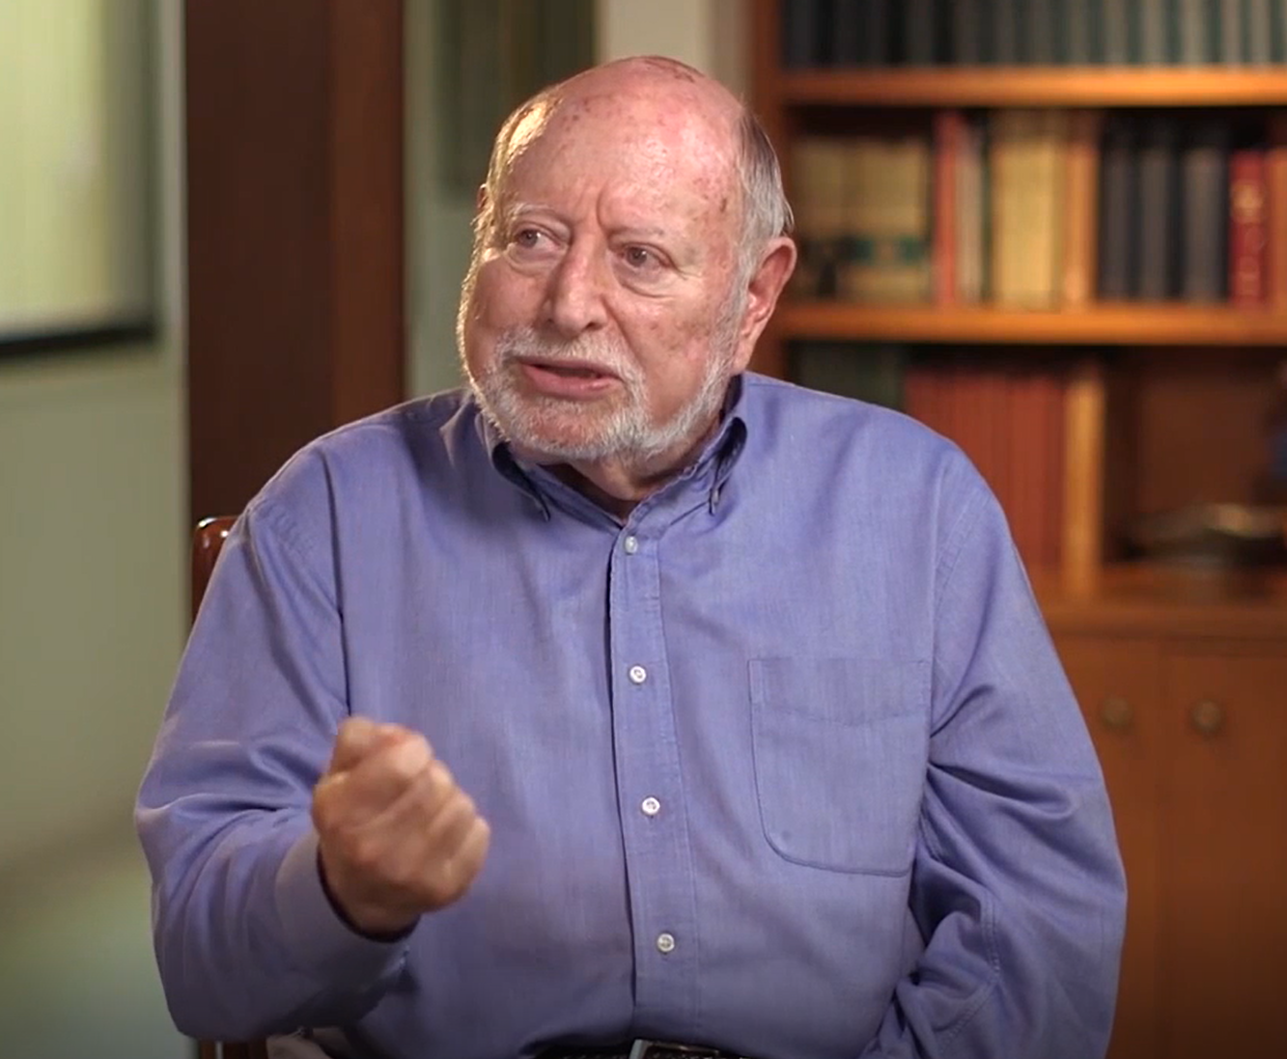
What is TPACK?
Shulman’s construct of pedagogical content knowledge (PCK)
Notes:
https://youtu.be/j3mTqIXJVuQ

Slide 23
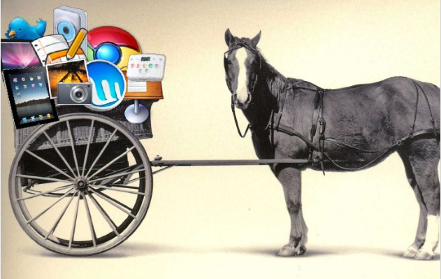
Transcend the Techno-centric Approach
Emphasis on technology in isolation
Computer labs, not integrated in the curriculum
New technologies are unstable, evolving and opaque, protean
Social and contextual contexts: lack of support, lack of preparedness, lack of training (one size fits all approach)

Slide 24
Unbundling the seven dimensions of the TPACK
Step 1: Examine each dimension individually
Dimension 1: Content knowledge (CK)
Dimension 2: Pedagogical knowledge (PC)
Dimension 3: Technology knowledge (TK)
Step 2: Examine the interplay of the three dimensions
Dimension 4: Pedagogical content knowledge (PCK)
Dimension 5: Technological content knowledge ( TCK)
Dimension 6: Technological pedagogical knowledge (TPK)
Step 3: Putting it all together
Dimension 7: TPACK

Slide 25
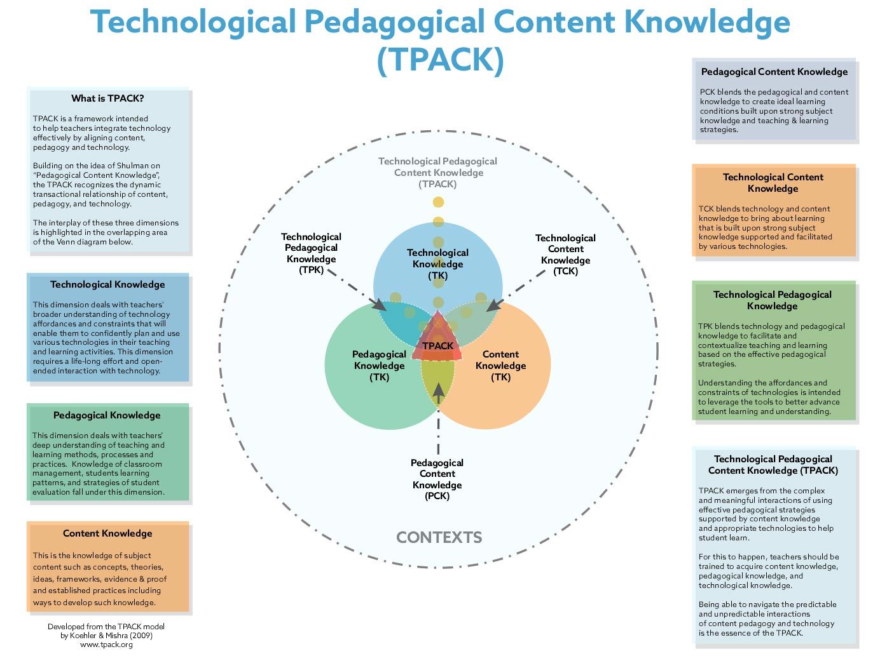
Notes:
Koehler, M. J., & Mishra, P. (2009). What is technological pedagogical content knowledge? Contemporary Issues in Technology and Teacher Education, 9(1), 60-70.

Slide 26
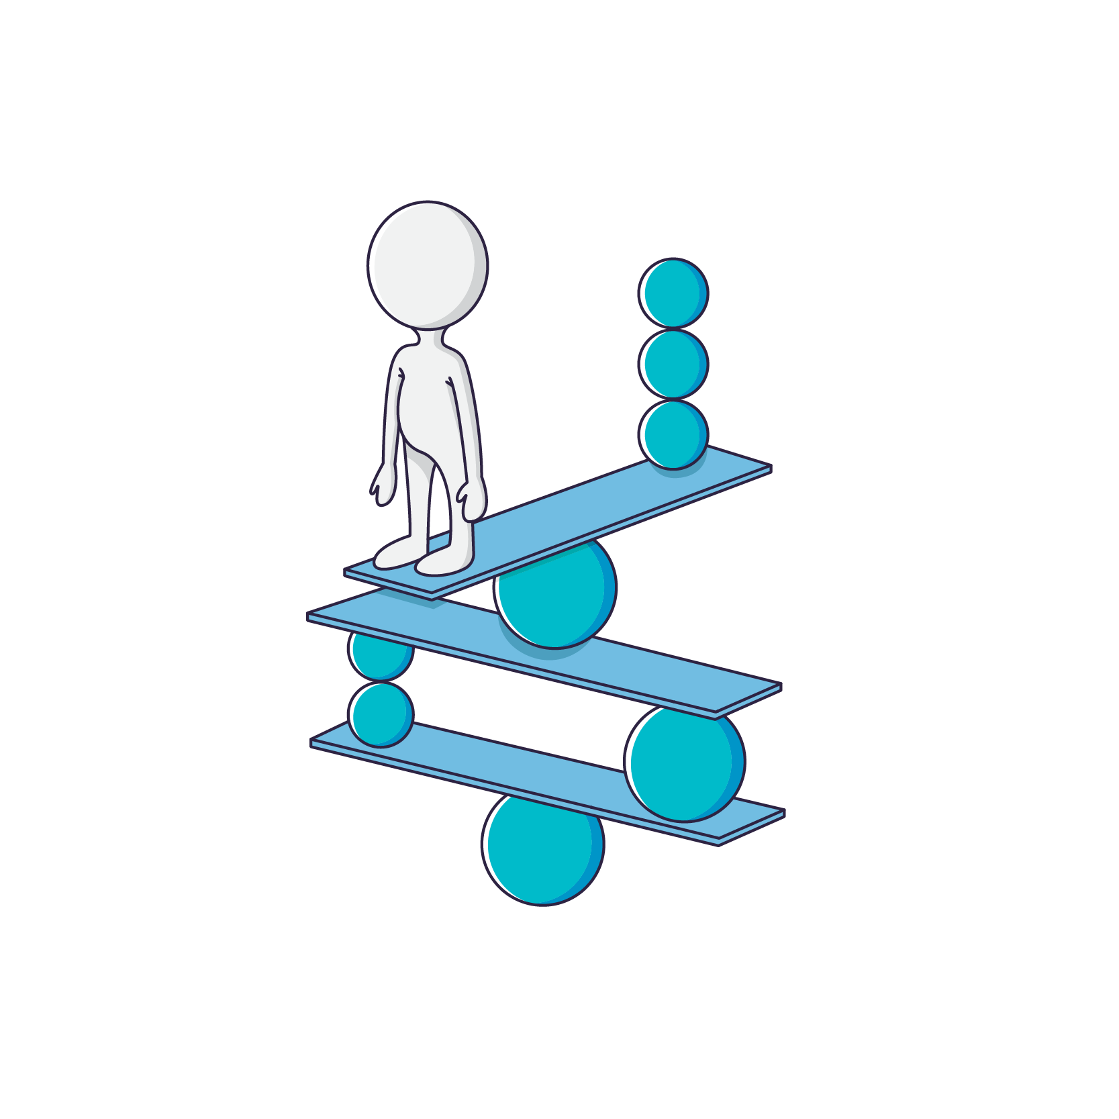
Equilibrium
Teaching successfully with technology requires continually creating, maintaining, and re-establishing a dynamic equilibrium among all components: content, pedagogy, technology, and teaching/learning contexts
Notes:
http://tpack.org

Slide 27
Critics of The TPACK
Where are the students in this framework?
Do we teach content or do we teach students?
What about the intrapersonal dimension: epistemological and pedagogical beliefs that teachers hold?
What about the cultural/institutional factors:
Physical/technological infrastructure, Support
Where are the students’ perceptions about learning?
Notes:
http://newmediaresearch.educ.monash.edu.au/lnm/stepping-back-from-tpack/

Slide 28
TPACK Cards Game

Slide 29
TPACK Cards Game
Choose a content card
Draft a question that you might cover in class
Pick a pedagogy card
Pick a technology card
http://fcit.usf.edu/matrix/digitaltools.php
Notes:
Adapted from
http://download.microsoft.com/download/3/B/7/3B734533-BC6E-4142-AD38-CF38D83D666E/TEI-Manual-for-Instructors-2015.pdf

Slide 30
TPACK Cards Game
Work with your group at your table
Justify your choice of pedagogy and technology:
How does the technology support your content?
How does the pedagogy support your content/pedagogy?
Is there another combination that fits better your content?
Which one? Why and How?

Slide 31
Final Thoughts
Dimension | Interrogations
Vision | What is your institutional vision for the role/place of ICT in your curriculum?
Competences | What competencies/standards are you targeting? And how do you ensure that your teachers are trained?
Infrastructure | What kind of infrastructure do you currently have in place? Will it scale and support your future ICT integration plans?
Software/hardware | Which software/hardware are you currently using in your pre-service teacher training?
Support | What kind of support do you have in place: technological, pedagogical?
Leadership | What kind of leadership support do you have for ICT integration?
Barriers and opportunities | What kind of opportunities and barriers faced by your teachers?

Slide 32
What did you learn?
Ideas gained from today’s sessions
Potential application for you work and your organization

Slide 33
Dr. M’hammed Abdous Old Dominion University mabdous@odu.edu
Thank you for your attention

